Slide 1
LAB FINAL
PROBLEMS 4.2 & 4.3
SHANNON MATUSZNY

Slide 2
LAB FINAL
Objective : Verify that reducing Boolean expressions is reliable in creating the same results as the original expression
Text Reference: Chapter 4, Problems 2 & 3
Items Used:
74LS04 – NOT GATE
74LS10N – 3 INPUT NAND GATE
7432N – OR GATE
74LS08 – AND GATE
74LS27 – 3 INPUT NOR GATE
3 TOGGLE SWITCHES
2 LED MONITORS
0-5 VOLT POWER SOURCE
MULTISIM

Slide 3
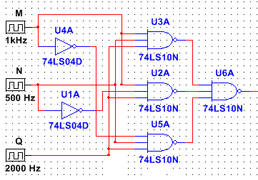
4.2 PROCEDURE
a) Make the Boolean formula from the following diagram
X =[(MNQ)’(MN’Q)’(M’NQ)’]’
X

Slide 4
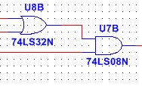
4.2 PROCEDURE
Mathematically simplify the equation from a) and draw out the diagram of the simplified equation.
X = [(MNQ)’(MN’Q)’(M’NQ)’]’
X = MNQ + MN’Q + M’NQ DEMORGANS
X = MQ(N + N’) + M’NQ 13A
X = MQ(1) + M’NQ 8
X = MQ + M’NQ 2
X = Q(M + M’N) 13A
X = Q(M + N) 15A
M
N
Q
Y

Slide 5
4.2 PROCEDURE
c) Draw the truth table for the expression derived from a).
Test Results
M | N | Q | (MNQ)’ | (MN’Q)’ | (M’NQ’) | X | X’ | X | Y
0 | 0 | 0 | 1 | 1 | 1 | 1 | 0 | 0 | 0
0 | 0 | 1 | 1 | 1 | 1 | 1 | 0 | 0 | 0
0 | 1 | 0 | 1 | 1 | 1 | 1 | 0 | 0 | 0
0 | 1 | 1 | 1 | 1 | 0 | 0 | 1 | 1 | 1
1 | 0 | 0 | 1 | 1 | 1 | 1 | 0 | 0 | 0
1 | 0 | 1 | 1 | 0 | 1 | 0 | 1 | 1 | 1
1 | 1 | 0 | 1 | 1 | 1 | 1 | 0 | 0 | 0
1 | 1 | 1 | 0 | 1 | 1 | 0 | 1 | 1 | 1

Slide 6
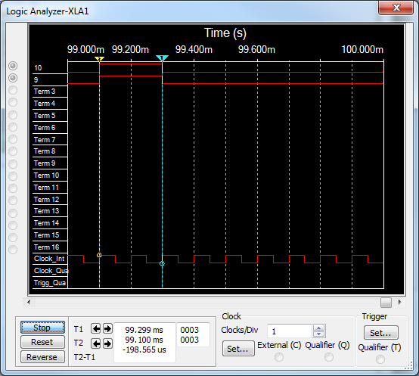
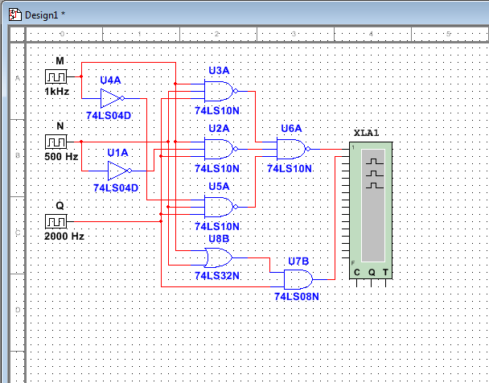
4.2 PROCEDURE
d) Build and test both the original circuit and the simplified circuit. Enter your results in the truth table in c) under Test Results. Verify that the test results, from both the original and simplified circuit, match the expected results in a) and b).
e) Build the circuit in Multisim and test the results using a Logic Analyzer.

Slide 7
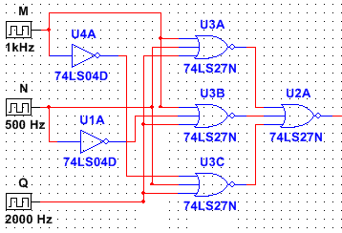
4.3 PROCEDURE
f) Change all of the NAND gates to NOR gates in the diagram in a). Draw the new diagram and derive a formula based off of the new diagram. Write the Boolean equation for the following circuit
X
X = [(M + N + Q)’ + (M + N’ + Q)’ + (M’ + N + Q)’]’

Slide 8

4.3 PROCEDURE
g) Repeat b) through d) using the expression in e) in place of the expression in a)
Simplified equation using Boolean Algebra and diagram
X = [(M + N + Q)’ + (M + N’ + Q)’ + (M’ + N + Q)’]’
X = MNQ + MN’Q + M’NQ DEMORGANS
X = NQ(M + M’) + MN’Q 13A
X = NQ(1) + MN’Q 8
X = NQ + MN’Q 2
X = Q(N + MN’) 13A
X = Q(N + M) 15A
M
N
Q
Y

Slide 9
4.3 PROCEDURE
Truth Table
Test Results
M | N | Q | (M+N+Q)’ | (M+N’+Q)’ | (M’+N+Q’) | X | X’ | X | Y
0 | 0 | 0 | 0 | 0 | 0 | 1 | 0 | 0 | 0
0 | 0 | 1 | 0 | 0 | 0 | 0 | 1 | 1 | 1
0 | 1 | 0 | 0 | 1 | 0 | 1 | 0 | 0 | 0
0 | 1 | 1 | 0 | 0 | 0 | 0 | 1 | 1 | 1
1 | 0 | 0 | 0 | 0 | 1 | 1 | 0 | 0 | 0
1 | 0 | 1 | 0 | 0 | 0 | 0 | 1 | 1 | 1
1 | 1 | 0 | 0 | 0 | 0 | 0 | 1 | 1 | 1
1 | 1 | 1 | 1 | 0 | 0 | 0 | 1 | 1 | 1

Slide 10
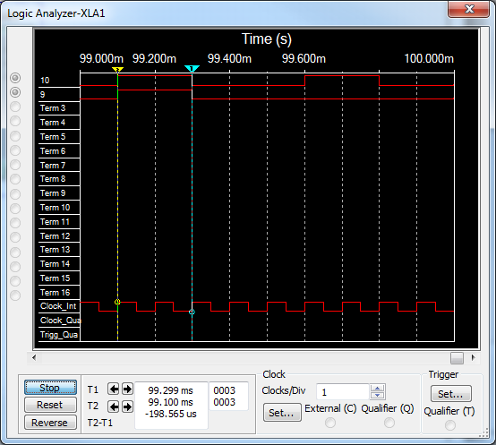

4.3 PROCEDURE
Build and test both the original and simplified circuit. Verify the results.
Build and simulate the original and simplified circuit in Multisim. Verify the results.

Slide 11
Analysis
Using Boolean Algebra in order to simplify circuits has many benefits in both simulation and actual operation. Processing time and cost efficiency are the main benefactors in simplifying circuits. By completing this lab, it was proved that reducing Boolean expressions is reliable in creating the same results as the original expresssion.

